Slide 1


Portfolio Analysis Challenge
UNDERSTANDING PERFORMANCE, RISK, AND DIVERSIFICATION
By Luis Pablo Aiello
Data Analytics Student

Slide 2
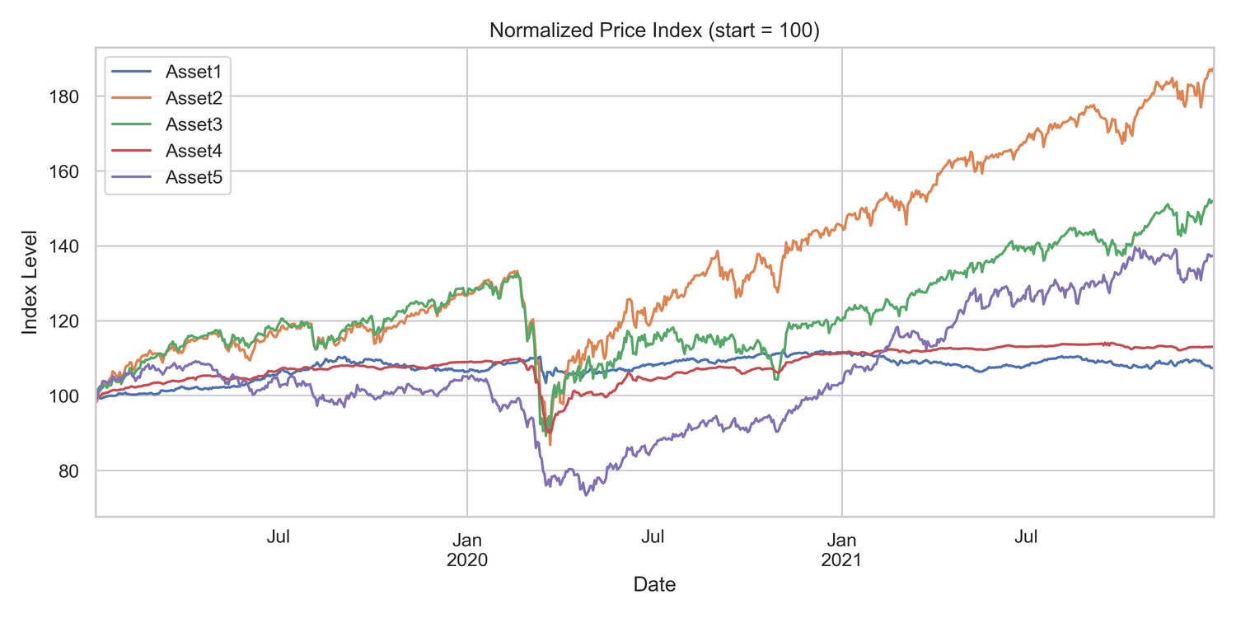
Analyzing Asset Behavior: Price and Returns
DAILY RETURNS CALCULATION
ASSET BEHAVIOR — PRICE GROWTH & DAILY MOVES
 | Asset1 | Asset2 | Asset3 | Asset4 | Asset5
Date
1/3/2019 | -0.002032 | -0.016072 | -0.005699 | -0.002707 | -0.009432
1/4/2019 | -0.00274 | 0.020954 | 0.025255 | -0.001125 | 0.019242
1/7/2019 | -0.001512 | 0.012632 | -0.007338 | 0.001856 | 0.014792
1/8/2019 | -0.001535 | 0.001003 | 0.00704 | 0.003605 | -0.000192
1/9/2019 | 0.001976 | 0.012919 | 0.002272 | 0.00412 | 0.014003
1/10/2019 | 0.001496 | 0.000642 | 0.005754 | 0.000361 | 0.000568
1/11/2019 | 0.001388 | 0.000434 | 0.000867 | 0.001608 | -0.001513
1/14/2019 | 0.001139 | -0.001785 | -0.006756 | -0.000033 | -0.003598
1/15/2019 | 0.001023 | 0.006546 | 0.005581 | 0.001245 | -0.00152
1/16/2019 | 0.000712 | 0.00797 | 0.000694 | 0.002977 | 0.0059
1/17/2019 | -0.000024 | 0.000513 | 0.000173 | 0.001142 | -0.001325
1/18/2019 | -0.000106 | 0.017517 | 0.018021 | 0.001401 | 0.01421
1/21/2019 | -0.000537 | -0.002017 | -0.002553 | 0.000846 | -0.002242
1/22/2019 | 0.001222 | -0.006064 | -0.004266 | -0.00039 | -0.008051
1/23/2019 | 0.00047 | -0.005881 | -0.002571 | -0.000716 | 0.00151
This analysis showcases how different assets behave over time, helping investors identify growth potential and volatility through visualized data.

Slide 3
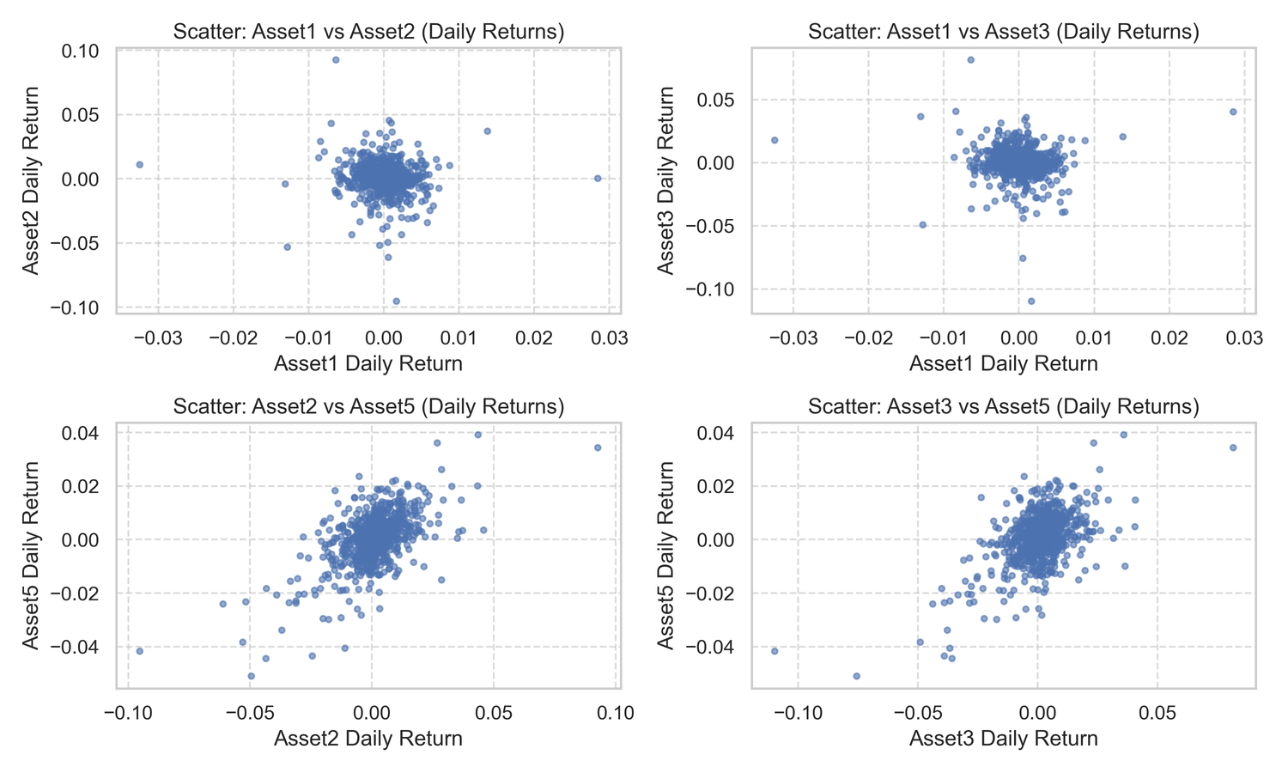
Understanding Asset Correlations for Diversification
ASSET MOVEMENT INSIGHTS
ANALYZING ASSET CORRELATIONS HELPS IDENTIFY DIVERSIFICATION OPPORTUNITIES, ENHANCING PORTFOLIO RESILIENCE AND REDUCING OVERALL RISK THROUGH STRATEGIC ASSET ALLOCATION.
CORRELATION MATRIX
Low/negative correlation = shock absorbers
 | Asset1 | Asset2 | Asset3 | Asset4 | Asset5
Asset1 | 1 | -0.088341 | -0.061253 | 0.102252 | -0.106484
Asset2 | -0.088341 | 1 | 0.852491 | 0.526634 | 0.591399
Asset3 | -0.061253 | 0.852491 | 1 | 0.51155 | 0.557414
Asset4 | 0.102252 | 0.526634 | 0.51155 | 1 | 0.421155
Asset5 | -0.106484 | 0.591399 | 0.557414 | 0.421155 | 1
CORR(ASSET5, ASSET1) ≈ −0.106 (SLIGHTLY NEGATIVE)
CORR(ASSET5, ASSET2) ≈ 0.591 (MODERATELY POSITIVE)
CORR(ASSET5, ASSET3) ≈ 0.557 (MODERATELY POSITIVE)
CORR(ASSET5, ASSET4) ≈ 0.421 (POSITIVE)

Slide 4
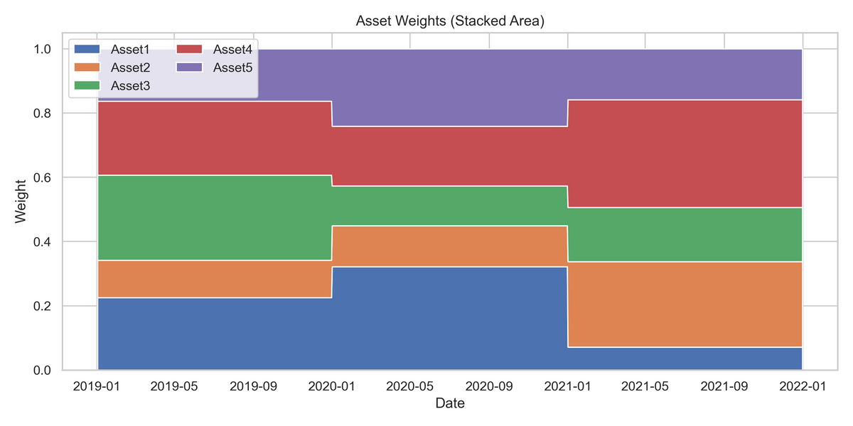
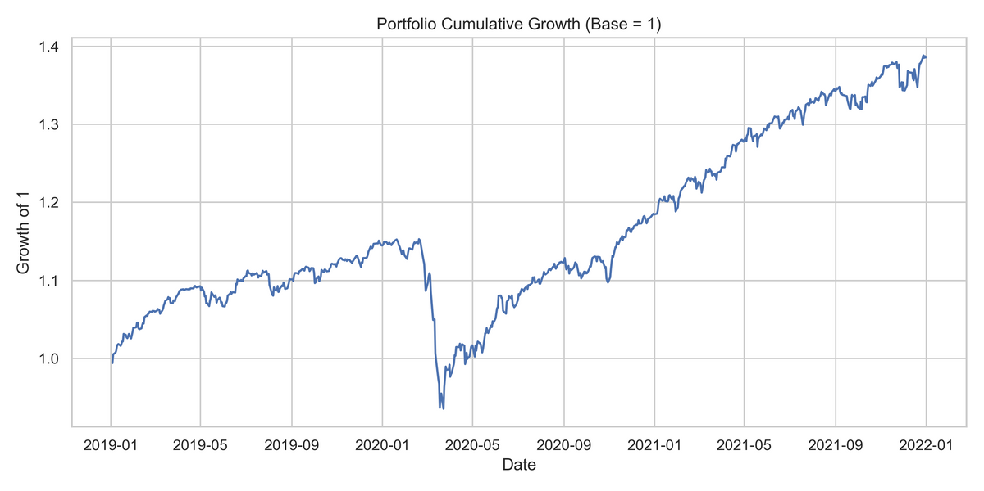
Performance & Risk Overview of Portfolio
Annualized Return ≈ 11.5%
— solid growth —
Annualized Volatility ≈ 8.5%
— moderate risk —
return/vol ≈ 1.35
— good quality —
ANALYZING GROWTH AND VOLATILITY
This section presents the portfolio's cumulative return over time, illustrating growth alongside moderate fluctuations, highlighting overall performance and risk levels.

Slide 5





RISK
REBALANCING
DIVERSIFICATION
Manage cluster risk by rebalancing to avoid overexposure
Enforce regular adjustment of weights as needed
Increase allocation to lower correlation assets for balance
DRAWDOWNS
KPIS
Monitor worst portfolio declines and recovery speed
Measure risk-adjusted performance with key financial ratios

Slide 6
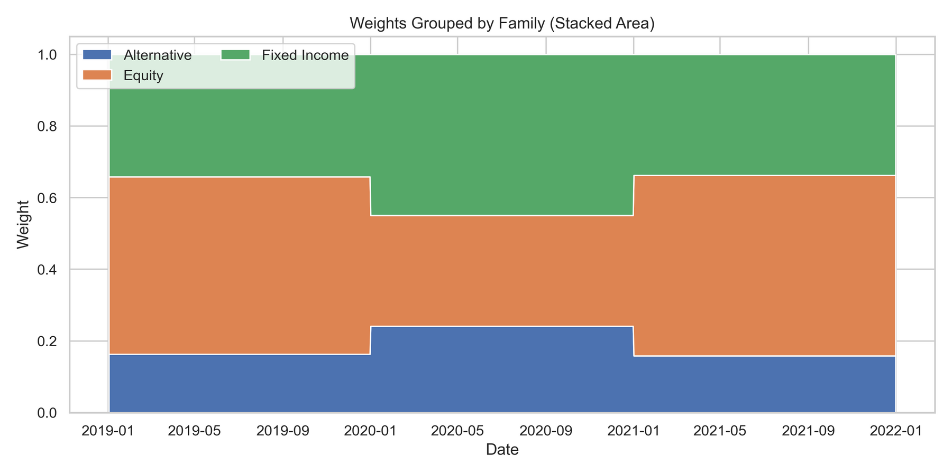
Family View of Portfolio Composition
THIS STACKED AREA CHART VISUALIZES PORTFOLIO WEIGHTS ACROSS EQUITIES, FIXED INCOME, AND ALTERNATIVES, ENSURING COMPLIANCE WITH POLICY LIMITS AND DIVERSIFICATION STRATEGIES.

